Slide 1
Bodo Okeyo
HOME
ABOUT
SERVIE
CONTACT

Slide 2

YOUR LOGO
HOME
ABOUT
SERVICE
CONTACT
TABLE OF CONTENTS
01.
02.
03.
Introduction
Findings
Summary
Overview
Business Understanding
Dtata Understanding.
Data analysis
Recommendations
Next Steps
Conclusion

Slide 3


INTRODUCTION
Overview
Using data from National transportation Safety Board to get insights and analysis on the risk fators of diffrent aircrafts
Business Understanding
My company is interested in purchasing and operating airplanes that have the lowest risk for commercial and private enterprises. r I am tasked with translating the data into actionable insights that the head of the new aviation division can use to help decide which aircraft to purchase.
HOME
ABOUT
SERVICE
CONTACT

Slide 4
Findings
- From my findings, aircraft makes Boeing, Airbus and Mcdonnels Douglas were the most frequently used for commercial purposes, whereas Cessna, Cyrus, Piper and Helicopter R44 were mostly used for personal enterprise.
- Makes, Boeing 777-206, Airbus A320-216, Airbus A310, Tupolev TU154, Antonov AN148 recorded the highest fatality rates.
- Whereas, Boeing 737, Boeing 777-206 Airbus A321, Airbus A330, Cessns 172 recorded the highest fatalities per incident.
- Overally, Cessna recorded the highest number of accident incidents, followed by a distant Boieng. Commercial planes recorded the least number of accident incidents as compared to private planes and helicopters.
- Airbus is the safest aircraft having recorded the least accidents incidents amongst commercial airplanes, Icon A-5, Mooney cadet A-2A and Thorp T-18-Tiger were the safest amongst private planes.

Slide 5
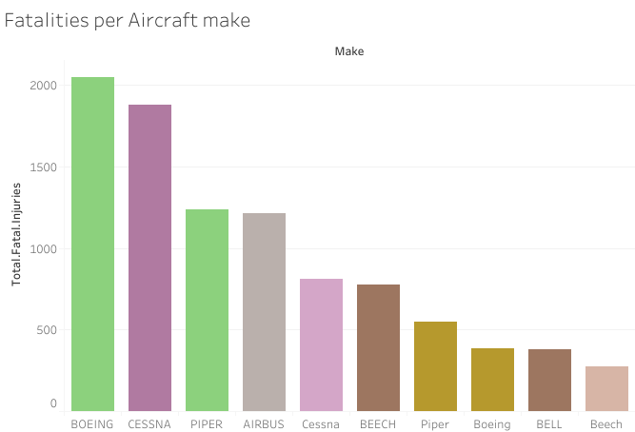

Slide 6
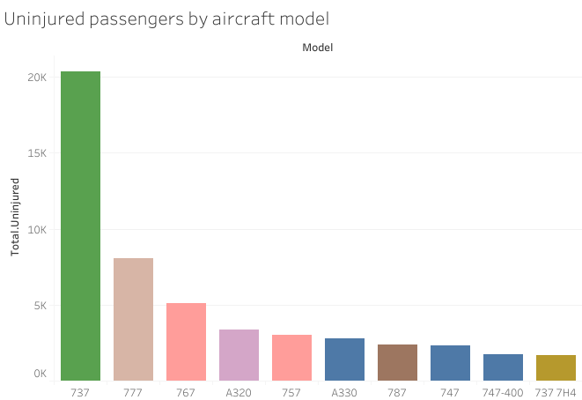


Slide 7
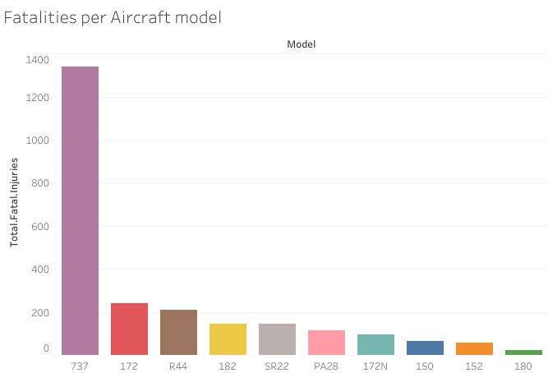


Slide 8
Recommendations
- Based on findings from the data, I recommend the company invest in the following airplanes for commercial
1. Airbus A321-211
2. Airbus A320-251
3. Airbus A320-277
4. Boeing 737
and the following for private enterprise;
1. Icon A-5
2. Mooney cadet A-2A
3. Thorp T-18-Tiger
OUR PROJECTS

Slide 9
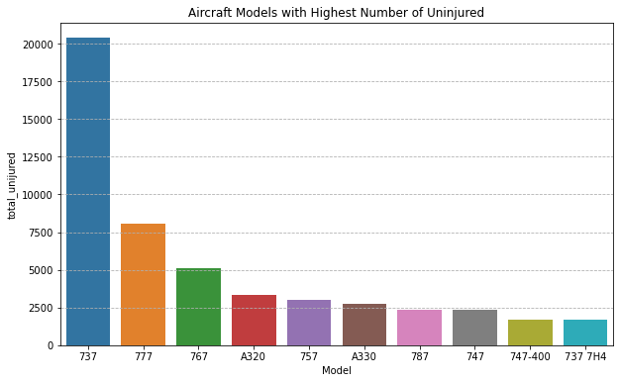

YOUR LOGO
HOME
ABOUT
SERVICE
CONTACT
OUR PROJECTS

Slide 10

YOUR LOGO
HOME
ABOUT
SERVICE
CONTACT
Evaluation and future improvements ideas
- Question & Answer sessions
- Feedback from the audience

Slide 11

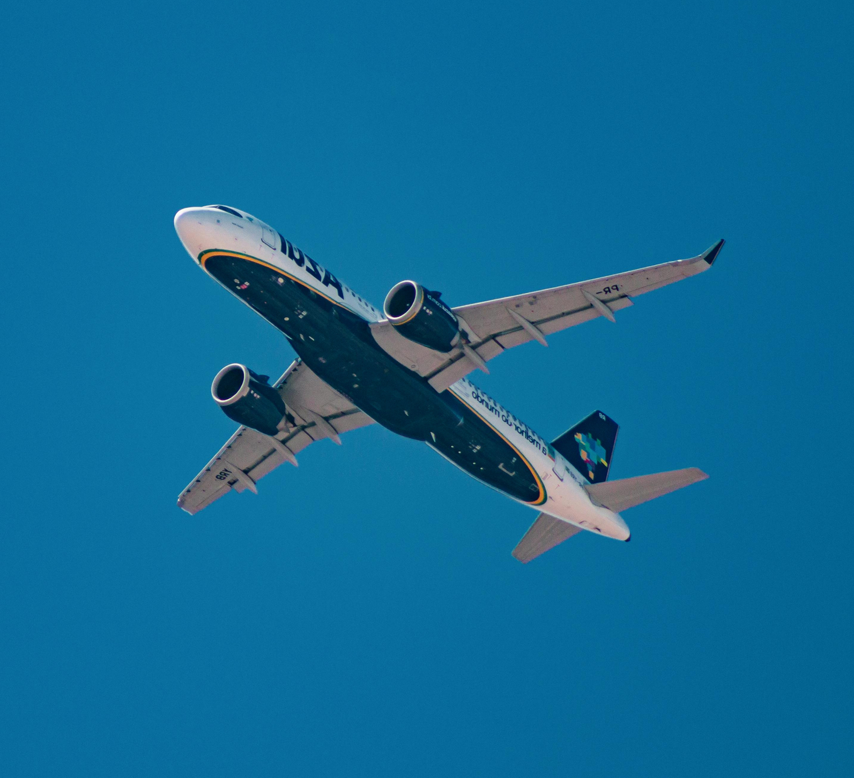

YOUR LOGO
HOME
ABOUT
SERVICE
CONTACT
CONTACT US
Nairobi
+254 718880888
bodookeyo@gmail.com

